Slide 1
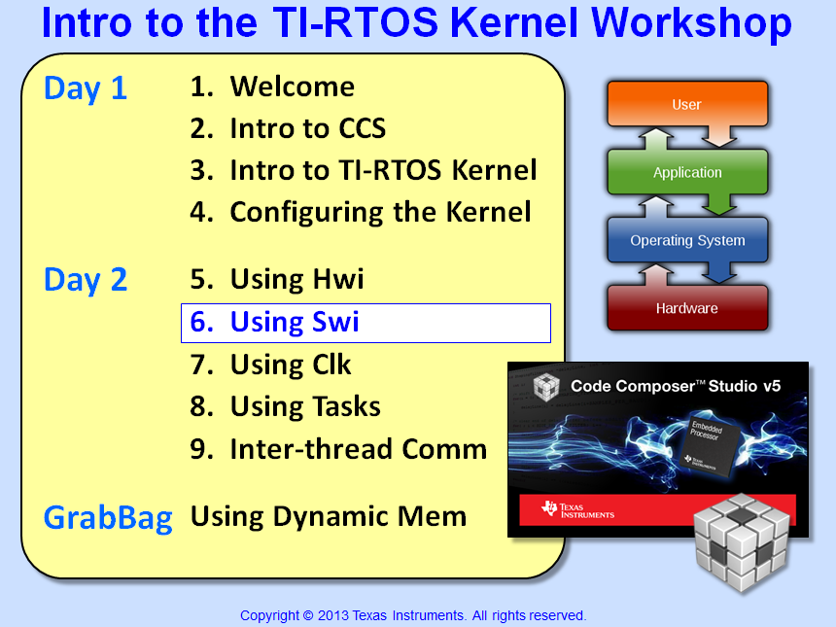

Slide 2
Objectives
Understand how Swi’s complement Hwi’s
Describe how to configure Swi’s
Detail how Swi’s are scheduled
Touch on Scheduling Strategies
Lab 6 – Use Swi to perform “Blink LED” instead of an Hwi.

Slide 3
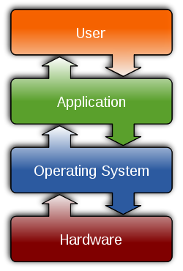

Outline
Using Swi
Intro
Scheduling Rules
Swi – Configuration
Other Useful APIs
Scheduling Strategies - FYI
Lab

Slide 4
Outline
Using Swi
Intro
Scheduling Rules
Swi – Configuration
Other Useful APIs
Scheduling Strategies - FYI
Lab

Slide 5
SYS/BIOS Thread Types (including Tasks)
Hwi
Hardware Interrupts
Hardware event triggers Hwi to run
BIOS handles context save/restore, nesting
Hwi triggers follow-up processing
Priorities set in silicon
Swi
Software Interrupts
Software posts Swi to run
Performs Hwi ‘follow-up’ activity (process data)
Up to 32 priority levels (16 on C28x/MSP430)
Priority
Task
Tasks
Usually enabled to run by posting a ‘semaphore’ (a task signaling mechanism)
Designed to run concurrently – pauses when waiting for data (semaphore)
Up to 32 priority levels (16 on C28x/MSP430)
Idle
Background
Runs as an infinite while(1) loop
Users can assign multiple functions to Idle
Single priority level
Using Hwi and Swi together…
Notes:
Using Clock Fxns in a Task-based video system is not really recommended because Clock Functions will ALWAYS have a higher priority than TSKs because periodic functions s are prioritized as Swis.

Slide 6
Hardware and Software Interrupt System
Execution flow for flexible real-time systems:
INT !
Hard R/T Process
Post Swi
Cleanup, RET
Hwi
Swi Ready
Continue Processing ...
Swi
Hwi
Fast response to INTs
Min context switching
High priority for CPU
Limited # of Hwi possible
isrAudio:
Swi
Latency in response time
Context switch
Selectable priority levels
Scheduler manages execution
*buf++ = *XBUF;
cnt++;
if (cnt >= BLKSZ) {
Swi_post(swiFir);
cnt = 0;
pingPong ^= 1;
}
TI-RTOS Kernel provides for Hwi and Swi management
TI-RTOS Kernel allows the Hwi to post a Swi to the ready queue
Scheduling Swi's...

Slide 7
Outline
Using Swi
Intro
Scheduling Rules
Swi – Configuration
Other Useful APIs
Scheduling Strategies - FYI
Lab

Slide 8
Scheduling Rules
Swi_post(swi_b)
Highest Priority
Hwi
Smart return from Hwi
swi_b (p2)
swi_a (p1)
Legend
Idle
Running
Ready
Lowest Priority
time
Swi_post(mySwi) : Unconditionally post a software interrupt (in the ready state)
If a higher priority thread becomes ready, the running thread is preempted
Swi priorities from 1 to 32 (MSP430/C28x has 16)
Automatic context switch (uses system stack)
What if the Swi's are at the same priority?
Notes:
This diagram shows two task of unequal priority. First the lower priority task is running and is interrupted by an ISR which then runs a higher priority task. The lower priority task running is preempted and rescheduled. After the higher priority task is completed it prompts the lower priority task to run

Slide 9
Scheduling Rules
Swi_post(swi_b)
Highest Priority
Hwi
swi_b (p1)
swi_a (p1)
Legend
Idle
Running
Ready
Lowest Priority
time
Processes of same priority are scheduled first-in first-out (FIFO)
Having threads at the SAME priority offers certain advantages – such as resource sharing (without conflicts) and reduced stack requirements.
How do you configure a Swi?
Notes:
If threads are at the same priority to solve the “resource conflict” problem, this can be dangerous IF someone comes along and changes the priorities. Be careful.

Slide 10
Outline
Using Swi
Intro
Scheduling Rules
Swi – Configuration
Other Useful APIs
Scheduling Strategies - FYI
Lab

Slide 11
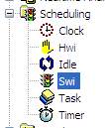

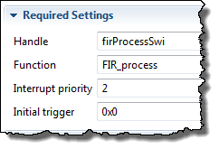
Configuring a Swi – Statically via GUI
Example:
Tie isrAudio() fxn to Swi, use priority 1
1
Use Swi module (Available Products) , insert new Swi (Outline View)
Remember, BIOS objects can be created via the GUI, script code or C code (dynamic)
2
Configure Swi – Object name, function, priority:
Notes:
Uint32 gie;
…
gie = IRQ_globalDisable();
...
IRQ_globalRestore(gie);

Slide 12
Outline
Using Swi
Intro
Scheduling Rules
Swi – Configuration
Other Useful APIs
Scheduling Strategies - FYI
Lab

Slide 13
SYS/BIOS Swi APIs
Other useful Swi APIs:
API | Description
Swi_inc() | Post, increment count in trigger
Swi_dec() | Decrement count, post if trigger = 0
Swi_or() | Post, OR bit into trigger
Swi_andn() | Zero a bit in trigger, Post if trigger = 0
Swi_getPri() | Get any Swi Priority
Swi_raisePri() | Raise priority of any Swi
Swi_getTrigger() | Get any Swi’s trigger value
Swi_enable() | Global Swi enable
Swi_disable() | Global Swi disable
Swi_restore() | Global Swi restore
Note: Can set “trigger” to any initial value (same as mbox in DSP/BIOS)

Slide 14
Outline
Using Swi
Scheduling Strategies - FYI
Lab

Slide 15



Scheduling Strategies
Deadline Monotonic
Most important = highest PRI
Rate Monotonic
Higher Frequency = highest PRI
Higher rates get higher priority
Easy way to assign priorities in a system
Systems under 69% loaded guaranteed to run successfully (published proof)
Stu Monotonic
All threads at equal priority
Place all threads at equal priority and then…
ONLY Raise priority of threads not making real time
Dynamic Priorities
Deadline approaching = raise PRI
Notes:
Systems under 70% loaded guaranteed to run successfully: only true for systems, in which all threads are regular (periodic), and independent of each other (i.e. no pend e.g.)

Slide 16
Outline
Using Swi
Intro
Scheduling Rules
Swi – Configuration
Other Useful APIs
Scheduling Strategies - FYI
Lab

Slide 17

Labs 5-9 “Roadmap”
Lab | Trigger | Hwi | Other | Fxn
5 | h/w timer | BIOS Hwi ledToggle
5B | BIOS timer ledToggle (Hwi)
6 | h/w timer | BIOS Hwi | BIOS Swi ledToggle
7 | BIOS Clock ledToggle (Hwi, Swi)
8 | h/w timer | BIOS Hwi | BIOS Task ledToggle
9 | h/w timer | BIOS Hwi | LED State → Mbx/Que →ledToggle

Slide 18

Lab 6 – “Blink LED” Using Swi
Lab Goal:
Instead of toggling the LED in the Hwi’s ISR, the ISR will now POST a Swi to toggle the LED
Procedure
IMPORT archived (.zip) project (please update to the latest BIOS/XDC/UIA)
Add Swi object (for ledToggle)
Build, “Play”, Debug
Use ROV/UIA to debug
Use Log_info() to print #toggles
main.c
main() {
init_hw();
Timer (500ms)
BIOS_start();
}
Scheduler
Hwi
Swi_post(LEDSwi);
Hwi ISR
Swi
ledToggle() {
toggle(LED);
Log_info();
}
Time: 45 min
LEDSwi
Idle

Slide 19


Slide 20
Outline
MainHighlight
MainNormal
SubHighlight
SubNormal

